Slide 1

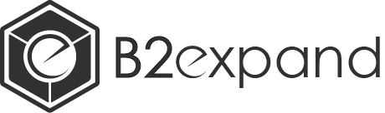
Hands-on Blockchain
Smart-contract development
https://github.com/Leo-Besancon/ISCTE-IUL-HandsOnBlockchain/

Slide 2
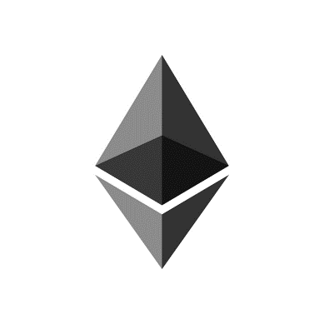
Blockchain smart-contracts
We will focus on the Ethereum Blockchain
First blockchain with smart-contracts support
More developer support compared to other blockchains
Solidity is the main smart-contract language

Slide 3
What is a smart-contract?
Execution, verification of contracts in a Blockchain environment
Blockchain brings transparency, decentralization, pseudo-anonymity and immuability
Applications
Decentralized finance
Games and gambling
Healthcare and other industries data management
Supply-chain automation and tracking

Slide 4
Ethereum overview
Second Blockchain by market capitalization
Cryptocurrency called Ether (ETH)
Was used to fundraise a lot of projects (Initial Coin Offerings)
Smart-contract development:
Compiled down to Ethereum Virtual Machine bytecode
Main language is Solidity
Also supports Vyper
Will support WebAssembly and many other languages in the future

Slide 5
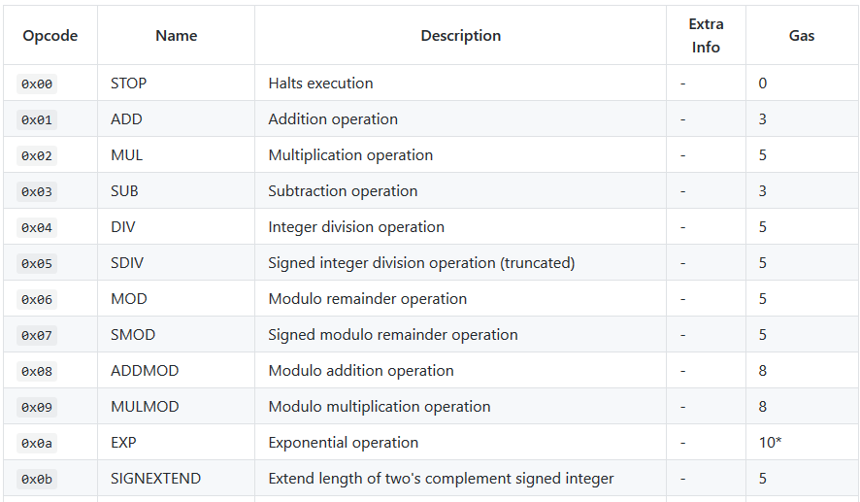
EVM Bytecode
Similar to assembly, contains a list of Opcodes

Slide 6
What is Solidity?
Language developed for smart-contract
Influenced by C++, Python and JavaScript
Quasi-turing complete
Includes a mechanism, called Gas, to avoid infinite loops and spam
Deterministic
Still under development (V0.6.2 of Solc, the Solidity compiler)

Slide 7
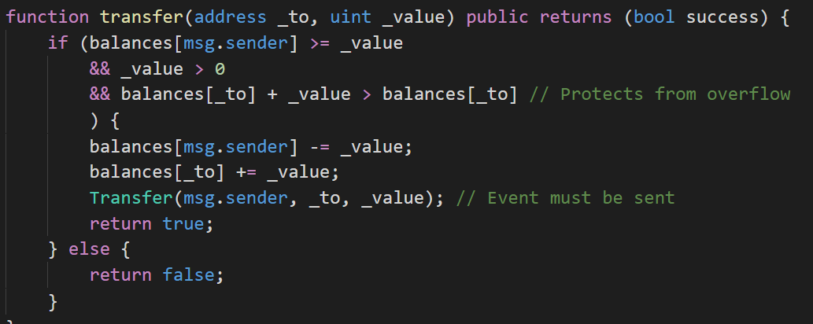
What is Solidity?

Slide 8
Solidity features
Available types:
uint = uint256
uintN, with N between 8 and 256
string
No floating-point numbers! It would contain too many edge-cases
address: a blockchain account
bytes32:
bytesN, with N between 1 and 32
Arrays
bytes: a byte array
uint256[]: a uint256 array

Slide 9
Solidity features
Available types:
structs
struct myStruct { uint256 _a; byte32 _b; }
mapping
mapping (address => uint256) _balances;

Slide 10
Solidity features
revert()
Will revert any state change and exit if encountered
Example:
require(bool b)
Will revert() if bool evaluates to false
modifiers
Can add a given code to a function

Slide 11

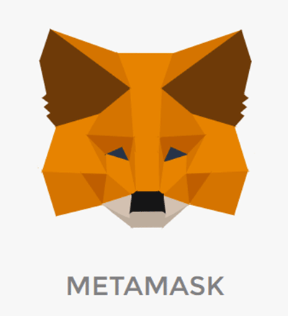

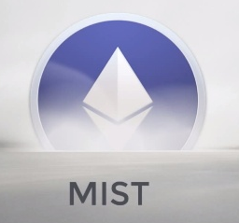
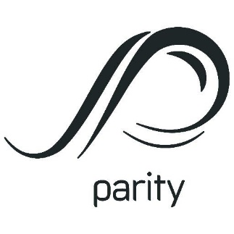
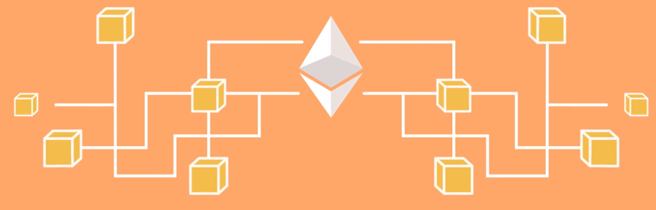
Ethereum ecosystem overview
Smart-contracts
Clients
Users
Developers
Write
Use
Query and
send transactions
Live
Ethereum Blockchain

Slide 12
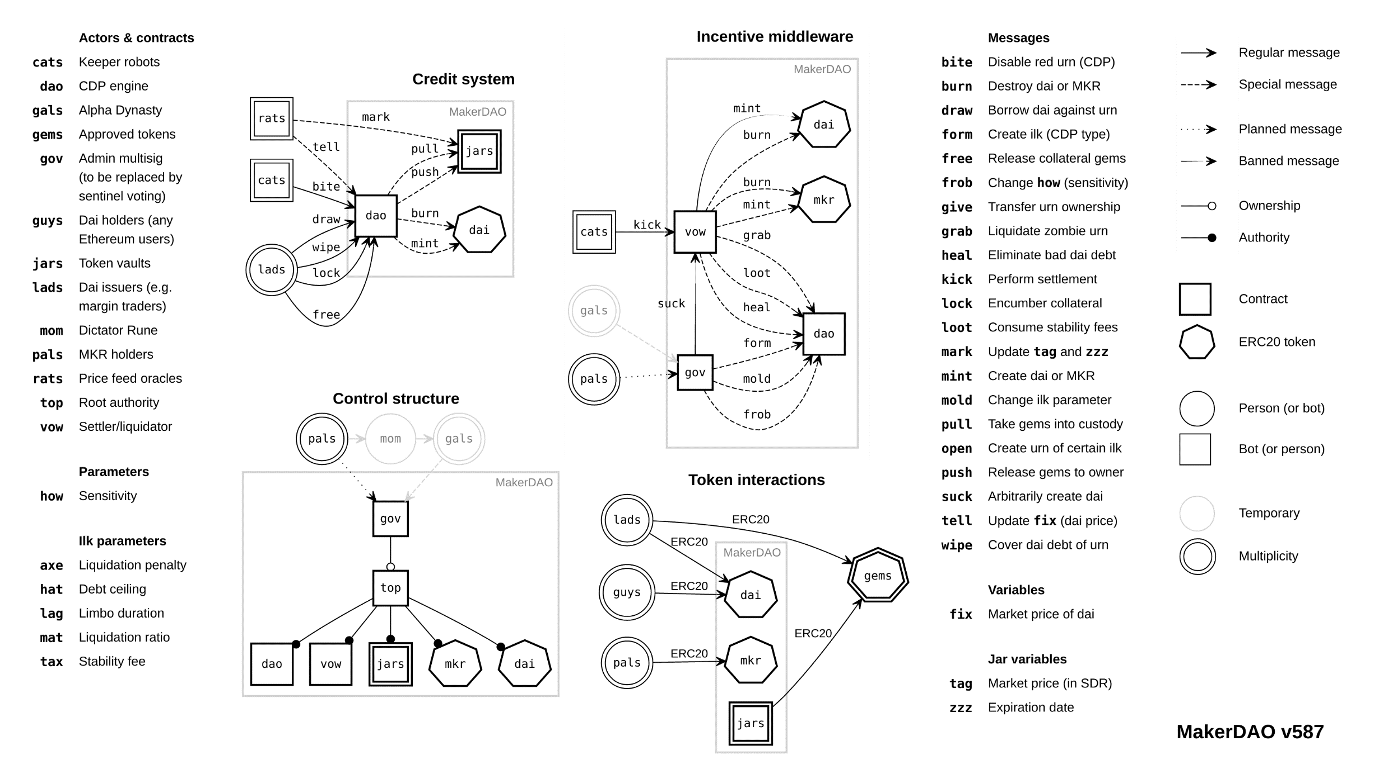
Smart-contract example

Slide 13
Hands-on experiments
Presentation of the tools
used in the Ethereum Blockchain ecosystem
Used to develop smart-contracts
Use boilerplate projects to familiarize yourself with them!
Smart-contract and solidity introduction
Best practices, and Decentralized Application development

Slide 14
Presentation of the tools
Remix IDE
Truffle Suite (Truffle and Ganache)

Slide 15
Your turn!
Try and create a new project on your development tool (Truffle or Remix)
Remix: already loaded in the workspace
Truffle: truffle unbox metacoin

Slide 16
Solidity introduction in practice
The ERC20 Token Standard
A Cryptocurrency managed by a smart-contract
Interface:
Optional
function name() public view returns (string)
function symbol() public view returns (string)
function decimals() public view returns (uint8)
Mandatory
function totalSupply() public view returns (uint256)
function balanceOf(address _owner) public view returns (uint256 balance)
function transfer(address _to, uint256 _value) public returns (bool success)
function transferFrom(address _from, address _to, uint256 _value) public returns (bool success)
function approve(address _spender, uint256 _value) public returns (bool success)
function allowance(address _owner, address _spender) public view returns (uint256 remaining)
Events
event Transfer(address indexed _from, address indexed _to, uint256 _value)
event Approval(address indexed _owner, address indexed _spender, uint256 _value)

Slide 17
Boilerplate projects
Try and import the ERC20 project in your IDE

Slide 18
Your turn!
Copy the sample code from the Github repository
Deploy the contract on your local Blockchain
Execute transactions

Slide 19
Your turn!
Try and implement a simple Rock-Paper-Scissors game in Solidity
Requirements:
Two player games: the first player will deploy a contract with a bet
The two players can then make a move (Rock, Paper, or Scissors)
Then the winner can withdraw his bet
Hint: In solidity, you can send Ether with
If(!_to_address.send(_value))
{
revert();
}

Slide 20
Rock-Paper-Scissors
/!\ Everything written to the blockchain is publicly available!
This means the second player can see what the first player move was, and choose a winning move accordingly
To avoid this, we could use a commit – reveal pattern
The first player must obfuscate his choice by hashing and salting his move. Then, after the second player made his move, the first one can reveal the salt and his move.

Slide 21
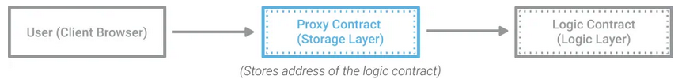
Best practices
Proxy contracts
Overcome Blockchain immutability: every program contains bugs! They should be upgradeable
We can create upgradeable contracts by pointing to another contract’s implementation

Slide 22
Best practices
Proxy contracts
Several ways to implement upgradeable contracts
Delegate every function call to the proxy contract
Only delegate known functions

Slide 23
Best practices
Smart-contract testing
Remix-tests
Truffle-tests
Allow you to write tests (in Solidity or Javascript) for you contracts
Edge-cases are pretty hard to spot, test extensively!

Slide 24
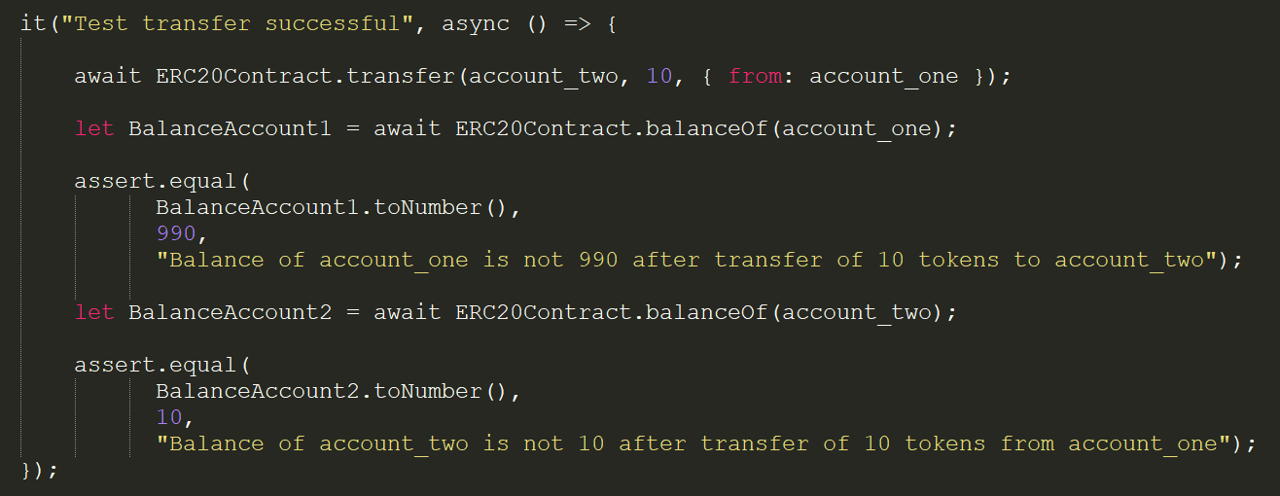
Best practices
Smart-contract testing
Sample code:

Slide 25
Best practices
Always keep security in mind
Sometimes, a developer may want to have admin access to his contract
A widely used concept is onlyOwner
However, it may lead to abuse of the contract from the developer side!
Safer alternative: onlyMultiOwner: several people from a given list must agree to every transaction made on an administration function call

Slide 26
Your turn!
Develop an onlyMultiOwner function!
Inputs: a list of owners (address[])
Output: a given function will execute only if 2 people in this owner list approve it. It will revert() otherwise.

